Slide 1

Pick up and Go
IEMS5709 – Term2 Group 17
Customer Flow and Popular Food Detection in Retail Store
Li Yonghui(李勇徽), Qi Jiadun(戚甲盾), Tian Hao(田昊), Hong Ziyang(洪子扬)

Slide 2
Background
Retail stores receive millions of visitors every year. The primary objective of a store is to attract visitors and make sales. However, this constant stream of traffic can be leveraged to create an alternate source of value for retailers. You can collect traffic data and extract key retail analytics from it. This provides insights into customer behavior and preferences, and by identifying common trends, you are better placed to maximize store traffic.
Consider this: you manage a furniture showroom, and store analytics indicate that 75% of your visitors are women. The data also shows that around 60% of your prospects visit between 10 a.m. and 3 p.m. on Saturdays. Based on this information alone, you can create a lot of sales opportunities and optimize store operations. Some retailers have constant access to such details because they actively collect and analyze store traffic data.
According to the National Retail Federation (NRF), only 47% of retail businesses leverage customer analytics, often due to a lack of fully integrated customer data or integration into other operational data. Sometimes, it is simply due to a lack of knowledge about using and leveraging such data.

Slide 3
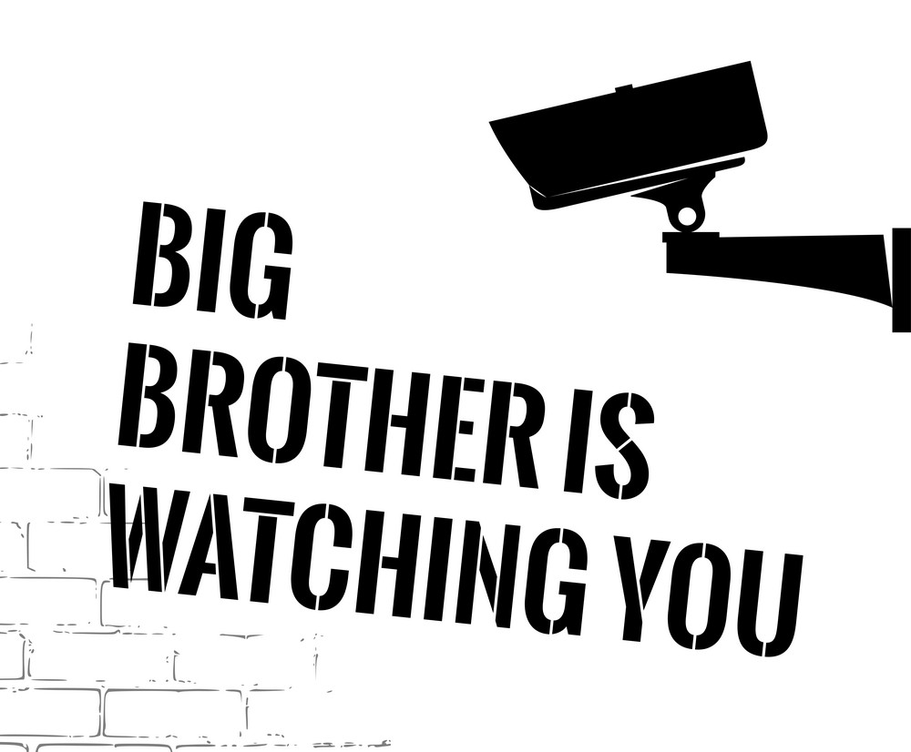
Where are the cameras?
Entrance of the store – Visitor Traffic and Street Traffic
Cashier – Purchase Traffic
Shelves – Theft protection
Definitions:
Customer Traffic: visitor traffic and purchase traffic
Popular goods: food/goods that most people buy
Declarations and legal requirements of using CCTV according local law.

Slide 4
Key elements
Peak/off-peak periods
Hours in a day: Provide insights of customer behavior, supply good in time
Season in a year: Supply chain and purchasing strategy
Draw-in rate & Purchase rate
Draw-in rate: Visitor traffic / Street traffic
Combined with pedestrians traffic data collected from street, determine the draw in rate of store. – How appealing is your store to the pass-bys
Purchase rate: Purchase traffic / Visitor traffic
Combine the traffic data of cashier and traffic data in store – How many customers want to buy after entering your store.

Slide 5
Key elements
Cross-features
Gender, Age
Goods of purchasing
Theft protection
Mismatch of purchase number (camera data from cashier) and the number of goods(camera data from shelves)

Slide 6
Our Implementation
Container: Use OpendataCam as base image, add video files and use yolo-tiny as model
ConfigMap: configure the file to count the person and pupular goods
YAML files: Deploy application over K8s
Counter: over the cashier

Slide 7
Container - Dockerfile
container1
FROM opendatacam/opendatacam:v3.0.2-xavier
COPY market1.mp4 /var/local/darknet/opendatacam_videos/market1.mp4
COPY market2.mp4 /var/local/darknet/opendatacam_videos/market2.mp4
CMD ./launch.sh
sudo docker build --tag market-detect:v1.7 .
sudo docker login
sudo docker tag market-detect:v1.7 jadenqi/market-detect:v1.7
sudo docker image push jadenqi/market-detect:v1.7
container2
mongo

Slide 8

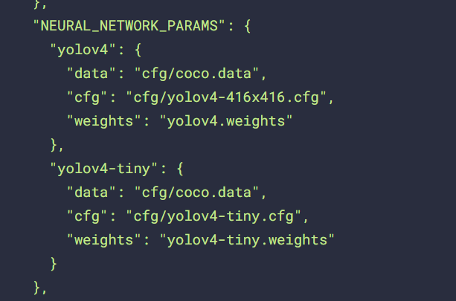
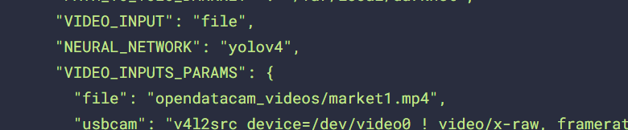
ConfigMap
traffic
foods/products

Slide 9
YAML files
Use correct container image
OpendataCam deployment and service
Use mongoDB to save data

Slide 10
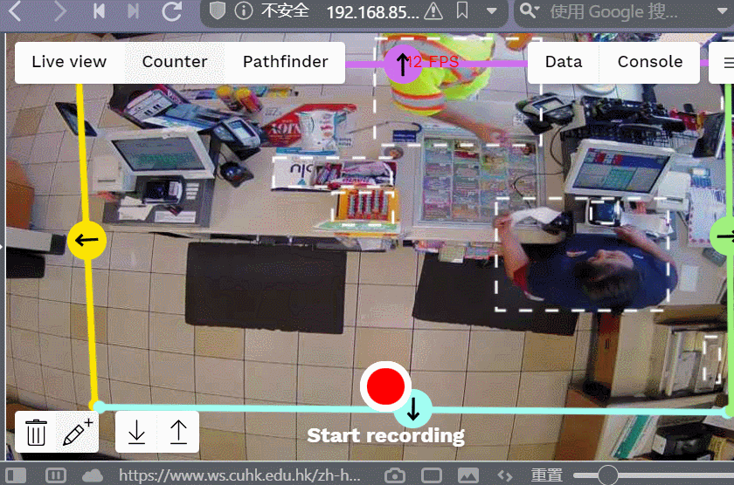
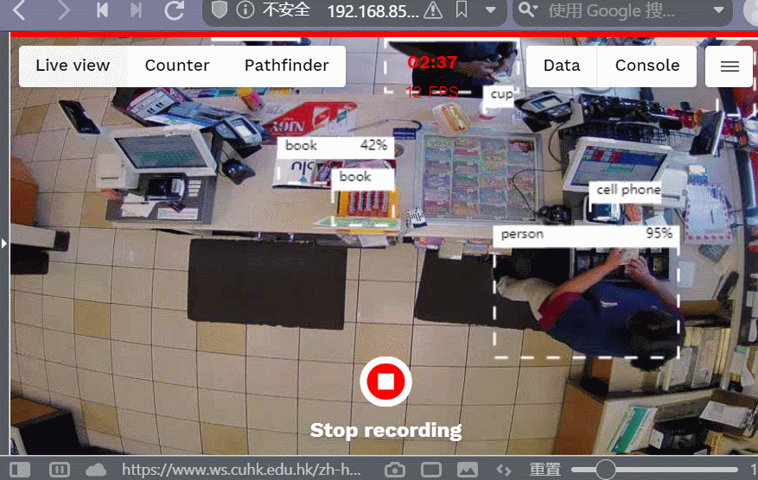
Outcome

Slide 11
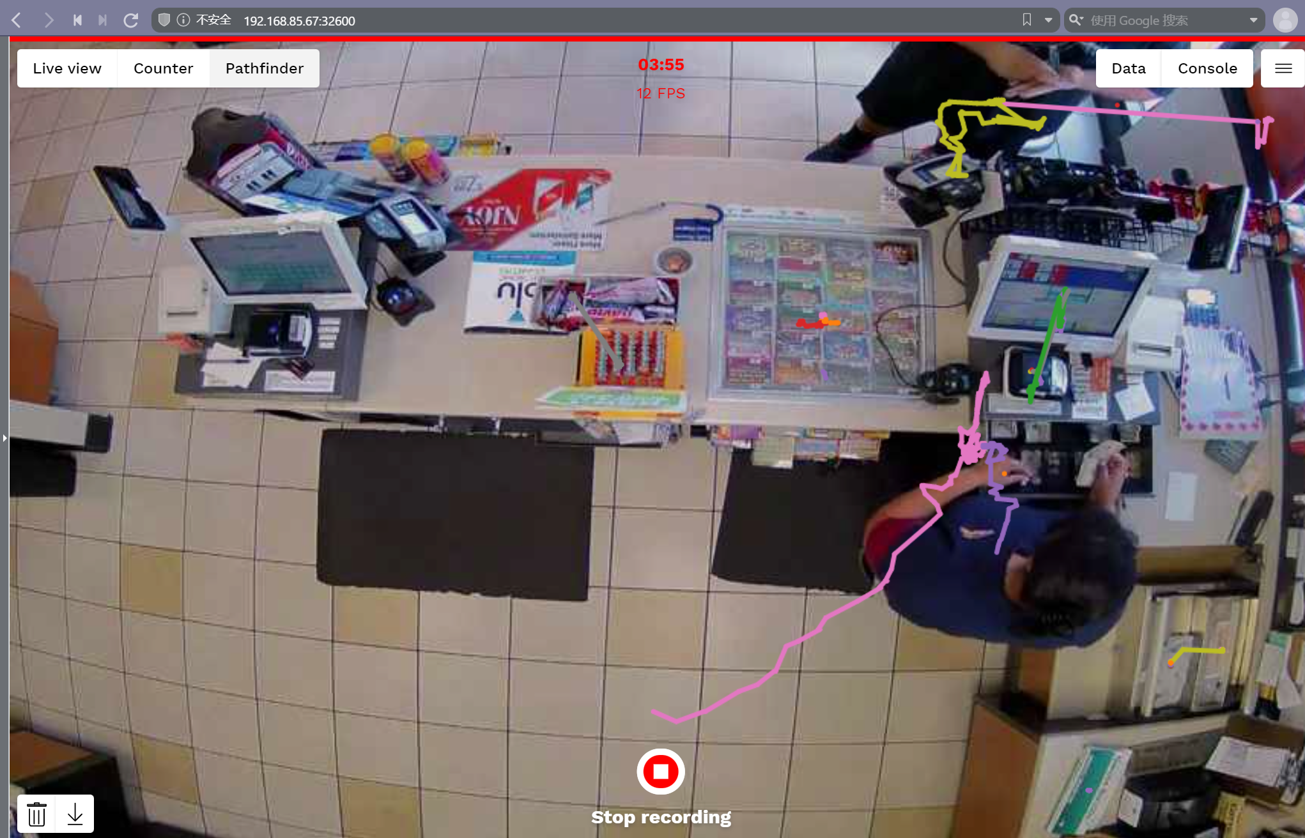
Outcome

Slide 12
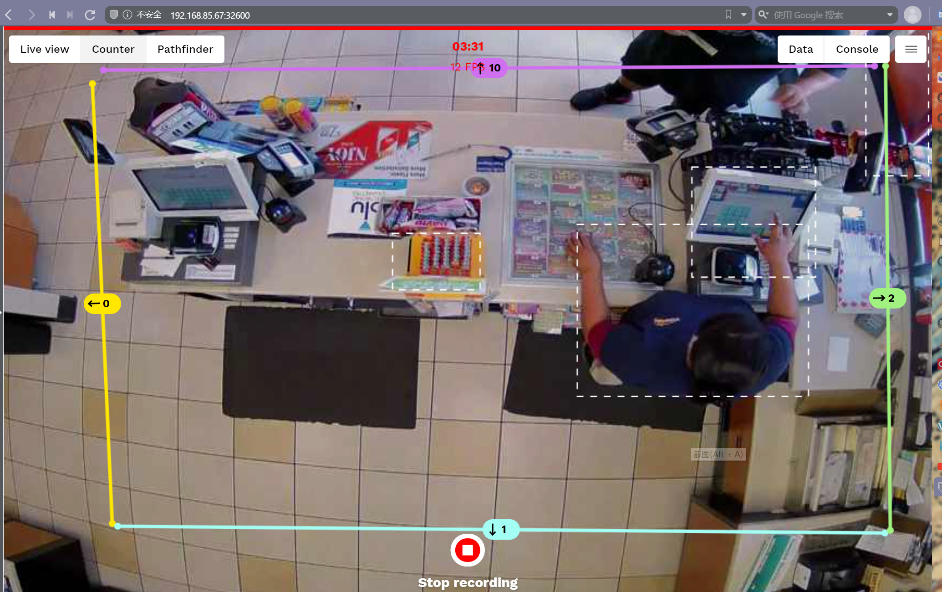
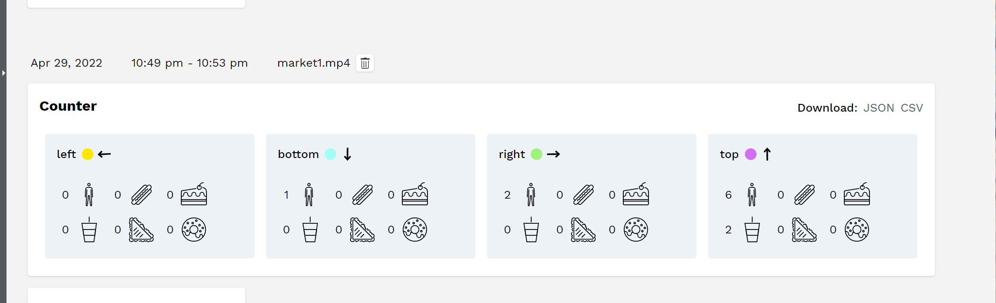
Counter

Slide 13
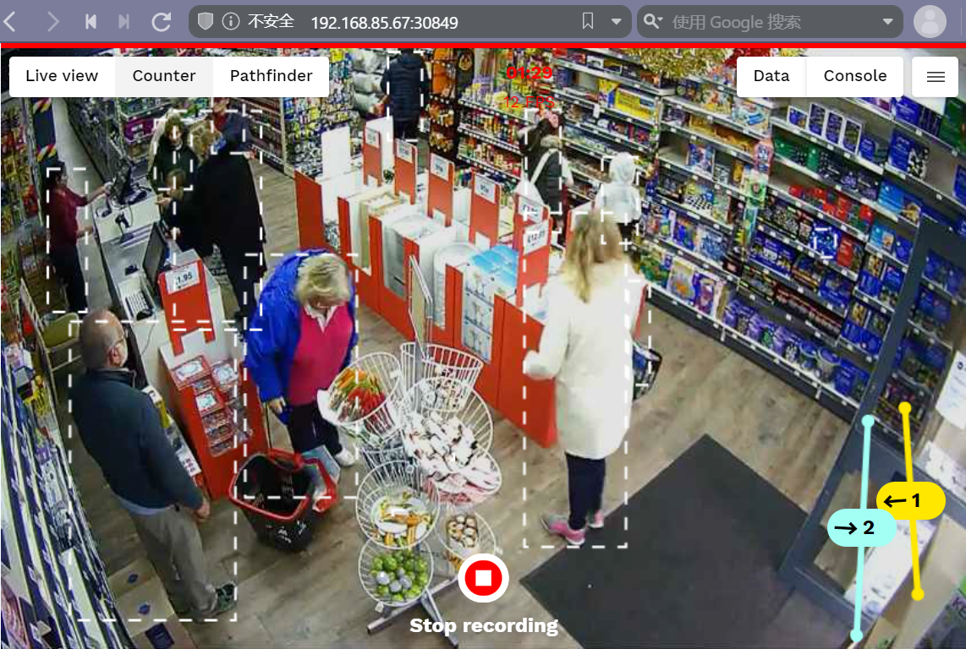
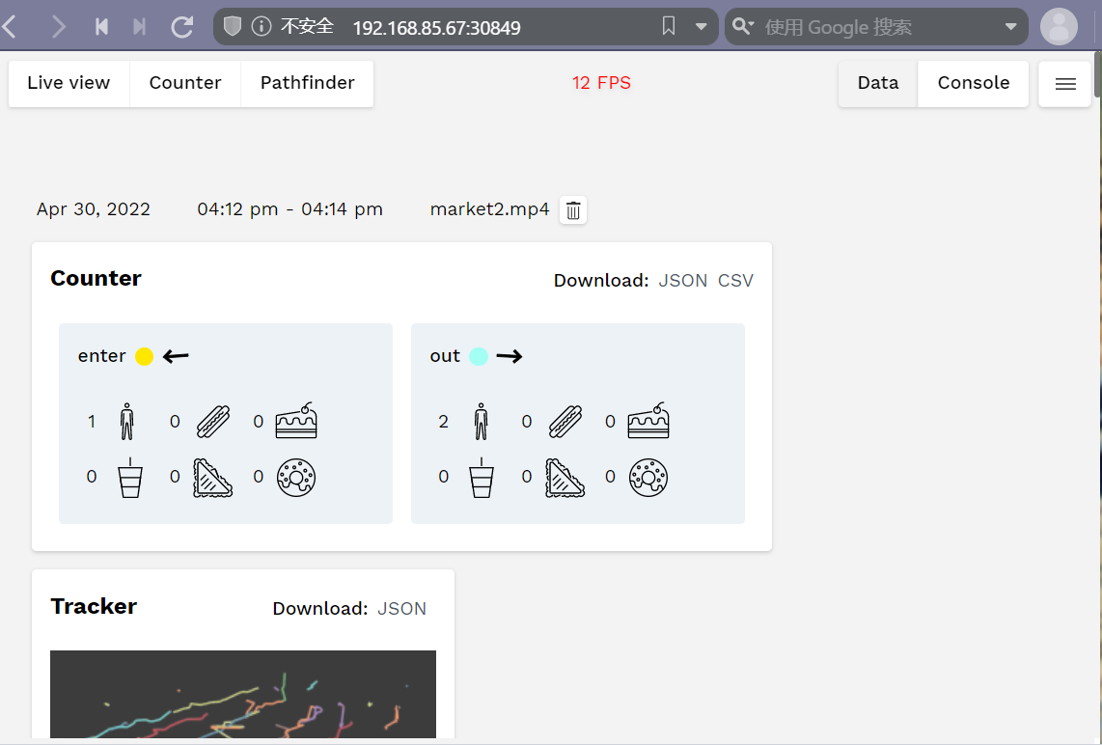
Counter

Slide 14
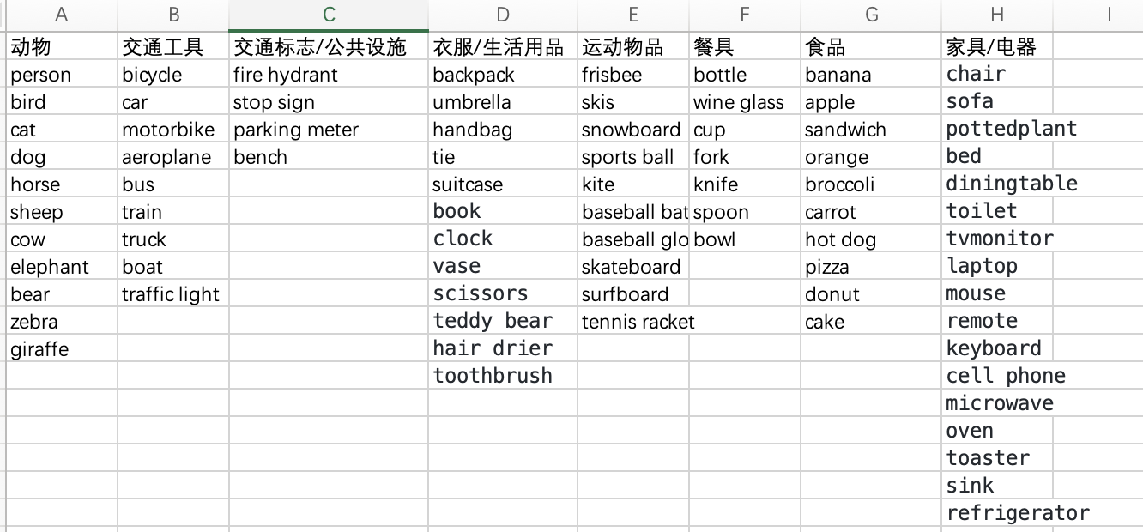
Other works
Pick up and Go – More accurate models to…
Differentiate more feature of customers:
Gender, Age, Occupation…
Differentiate more kinds of products/foods
More than Hot dog, cake, chips, coffee etc.
Trt-pose – Under progress
https://github.com/AlexeyAB/darknet/blob/master/data/coco.names
Thanks cooperation of Group5 and Group13, they help to explore use of container building and how to implement new models. Learning together helps us progress.

Slide 15
Our Works
Separation of duties
Tian Hao: Works on environment configuration, help to solve problems on environments mismatch
Li Yonghui: ConfigMap and YAML file for this project and TRT-pose
Qi Jiadun: Dockfile, build container for this project and TRT-pose
Hong Ziyang: Documents records and communicate

